Slide 1
HACK OVERFLOW
Batch number:A125
Name of the student:
1. S.Harish
2. B.Vishal Chandar
3.G.Balamurugan

Slide 2
Project Title:
AUTOMATIC FLAVOUR DISPENSER
INTRODUCTION:
Automatic flavour dispenser is a machine which is used to dispense the liquid of different flavour. We use this project in the field of chat like Golgappa(Panipuri),where it helps to dispense different flavours of liquid (Sweet,Spicy, Both- Spicy & sweet) automatically when we place the golpappa below the nozzle.

Slide 3
PARTS & PURPOSES:
TANKS:
To store the different kind of flavours in it.
SOLENOID VALVES:
Used for the purpose of allowing the specified quantity of liquid.
ULTRASONIC SENSOR:
Used to sense the golgappa whether it is placed below the nozzle or not.
POTENTIOMETER:
Used for the purpose of selection of the liquid flavours.
MICROCONTROLLER:
It helps to controll the whole process. We are planning to use Atmega controller

Slide 4
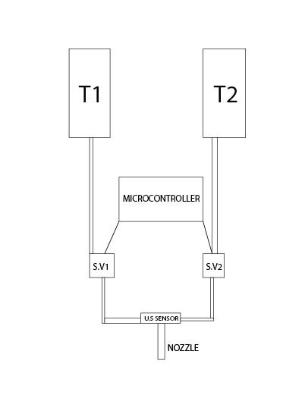
WORKING DIAGRAM:

Slide 5
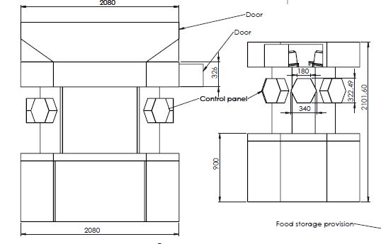
MACHINE DIAGRAM:
AUTO CAD : 2D DIAGRAM

Slide 6
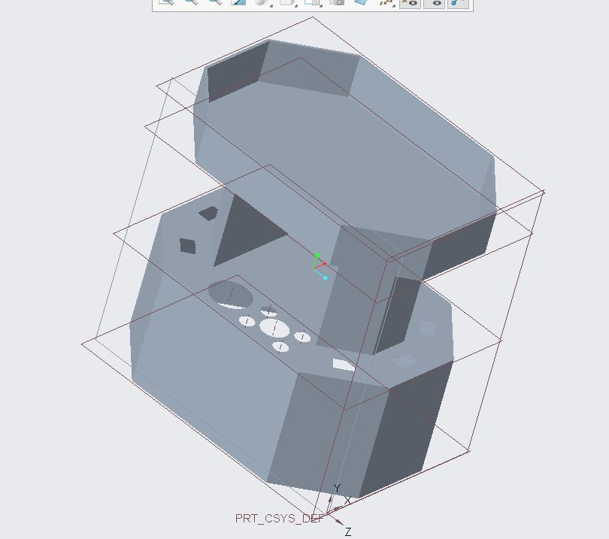
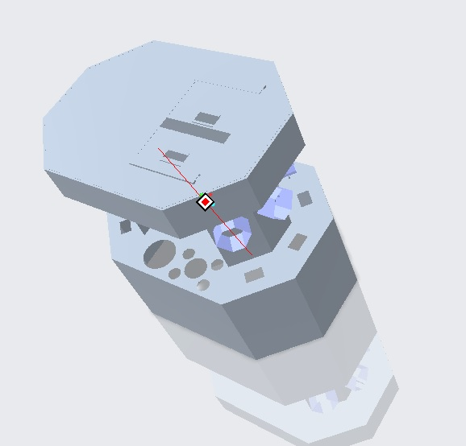
CREO: 3D MODELLING
REVIEW 2
IMPROVISED DESIGN REVIEW 3

Slide 7
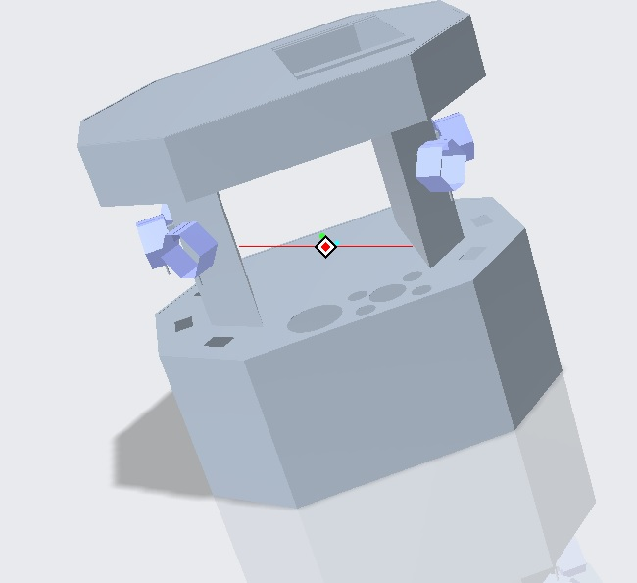
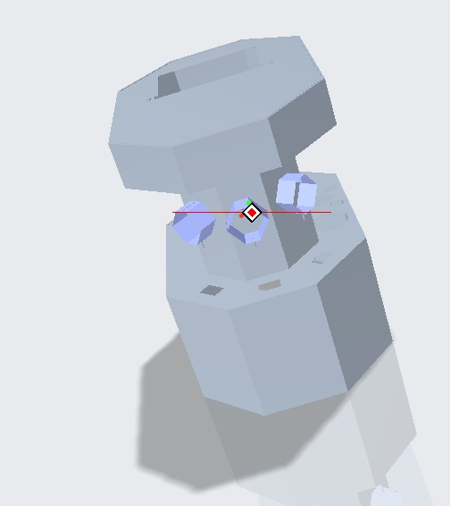
BACK VIEW
SIDE VIEW

Slide 8
OBJECTIVES:
USE:
Health & hygiene
To quantify the liquid
To reduce customer time loss
Easy accessie for customers
Can be used in food industries for small scale business.

Slide 9
CASE STUDY
TEST CASE1:
WHAT IS INNOVATIVE?
In our dispenser we have additionally combined the conveyor mechanism, so that if a person comes at counter 1,we have a push button near the seller , so that after placing the ingredients in the tray when we press the button it travels to the counter 1 and stops, with placing the sensor in the tray we detect whether the object is taken or not, if no object is sensed the conveyor tray will come to its rest position. Likewise it is worked according to the counters respectively.

Slide 10
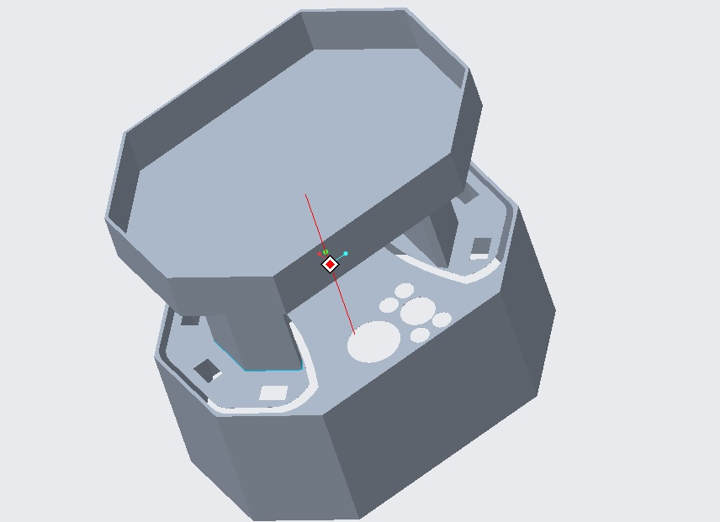

Slide 11
TEST CASE2:
COST EFFECTIVENESS:
For the reduction of cost we are using mild steel instead of stainless steel in certain places other than food storage places because mild steel will get rusted easily, to avoid that we are adding a powder coating for mild steel.
Stainless steel is only used for food storages and flavour passages, so that cost gets effective and doesn’t lead any health issues.

Slide 12
TEST CASE3:
How does the flow managed?
The flow of liquid is managed by placing the tank slightly in angled position and at the end of the pipe a separate small tank consisting of a reducer is designed which helps to separate our pipeline.
At the end of the 8mm pipeline we connect a solenoid valve which stops the fluid flow and opens when the circuit gets closed by controlling it, where the pressure variations is controlled.
In addition to that if the fluid level is low at the tank we can fix a float sensor switch so that it will indicate us when the fluid level is low so that we can refill the tank

Slide 13
TEST CASE4:
Same Technology Which can be used in other Fields:
In medical field the objective is to regular medication of the patients on time without any fail. The pills for 1 month is loaded in the tube and it is programmed as per the prescription and the time the pills needed to be taken is also programmed using the arduino, if not the pills is taken then the buzzer will ring and aware the person to take the pills ,if he already took the pills then the webcam in a setup will sense and the buzzer remains off WORKING The high power relay switches which is same as the function of solenoid , when it is energized the component will expand and push the pills out of tube

Slide 14
COST ESTIMATION:
This estimation is created accordingly with the help of websites like amazon,flipkart,indiamart,robu.in. This cost may differ, it has a chances of increasing or decreasing in the total cost
WITHOUT CONVEYER LINE
Manufacturing & Fabrication – Rs.30520
(Excluding Transportation & Labour cost)
Electrical work - Rs.12327
-----------
TOTAL - Rs.42847
------------

Slide 15
WITH CONVEYER LINE
Manufacturing & Fabrication – Rs.30520
(Excluding Transportation & Labour cost)
Electrical work - Rs.12327
Conveyor Line - Rs.20000(approx.)
-----------
TOTAL - Rs.62847
------------

Slide 16
COST SPLIT UP:
Nos.
ELECTRICAL:
Microcontroller board - 4200(approx) 7
Solenoid 12v - 1920 12
2 channel relay switch - 540 6
LED Lights - 40 10
Ultrasonic Sensor - 600 6
8mm R.O Pipe - 175 10m
2 to 1 Converter joint - 60 10
Potentiometer - 540 6
On/Off Switch - 120 6
Agitator & Motor - 1800 4
Float sensor switch - 350 2
3 Plugin Chord - 150 1
Jumper Cable - 60 Pack
Copper Wires - 172 10m
SpotLight - 1500 8
TOTAL - 12327

Slide 17
FABRICATION:
S.S Material (Tank & pipe) 1.6mm thickness/7kg - 2500
M.S Material ( Body) 1.6mm thickness/305kg - 13500
Square Pipe ( Frame) 40mm - 4000
Powder Coating - 7000
Plastic tray - 120
Hose Pipe - 300
Plastic tank - 200
Reducer - 1200
Screw & Bolt - 300
Hinges - 400
S.S food storage - 1000
-------------
TOTAL - 30520
----------

Slide 18
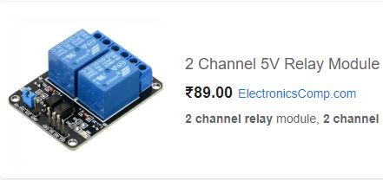
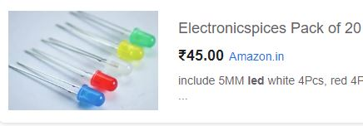
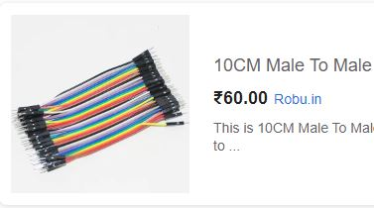
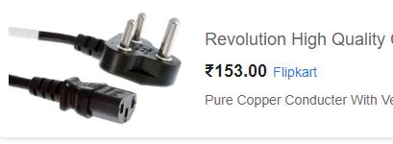
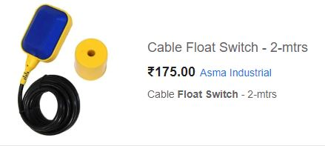
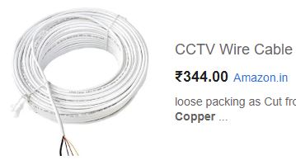
REFERNCES:

Slide 19
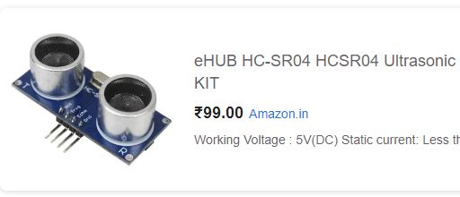
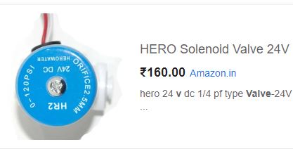
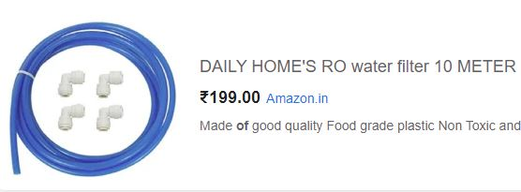
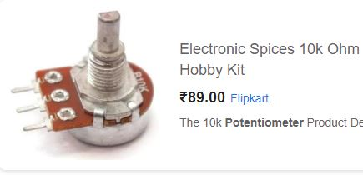
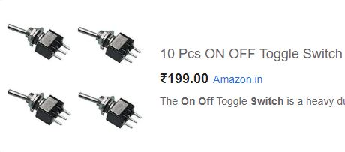
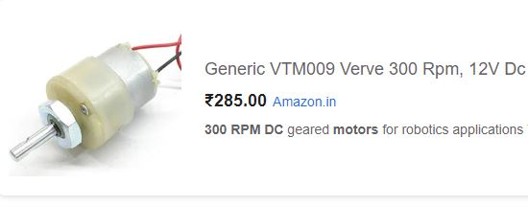

Slide 20
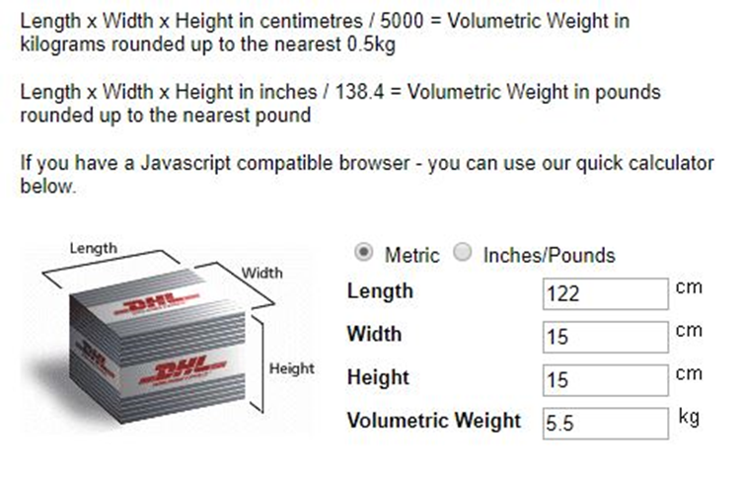
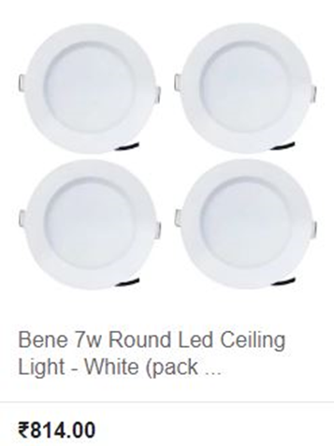
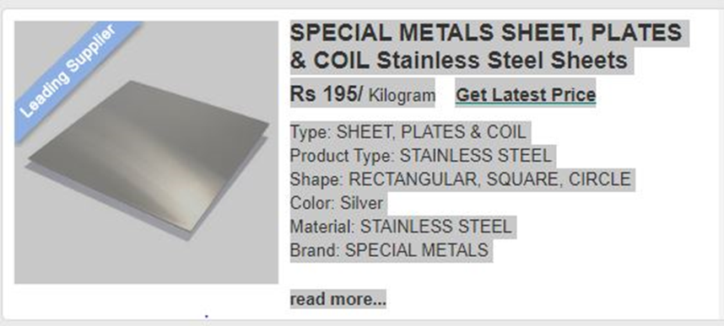

Slide 21
THANK YOU!

